Slide 1
Design Credit Presentation
Indian Institute of Technology, Jodhpur
Project - Modulation of Variable Transformer using Arduino for constant Power output
Nikhil Gangwar(B20ME049)
Faculty Supervisor - Dr. Sudipto Mukhopadhyay

Slide 2
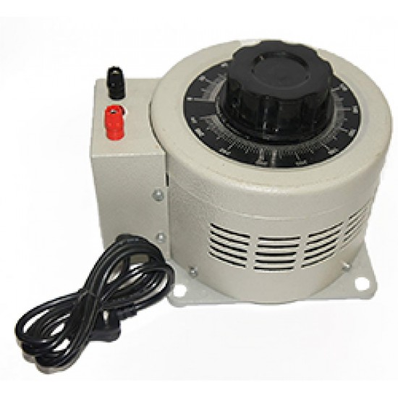
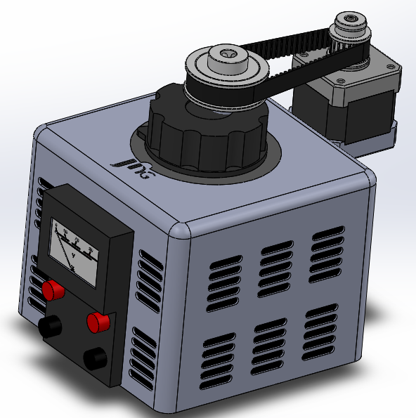
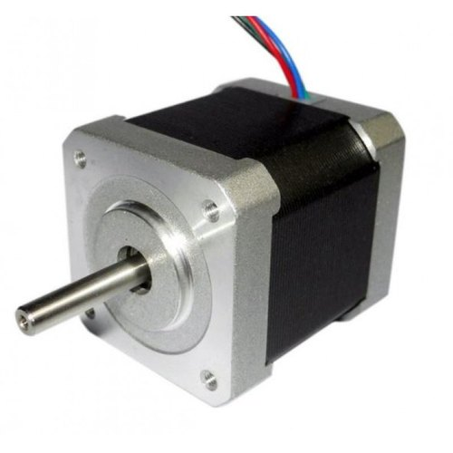
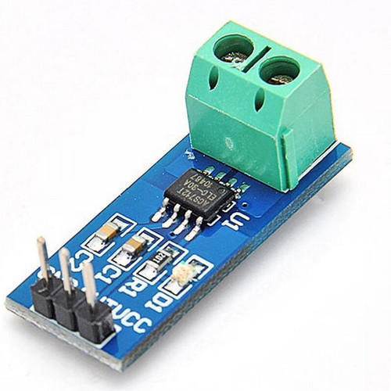

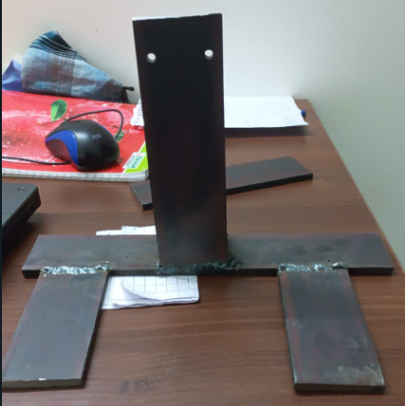
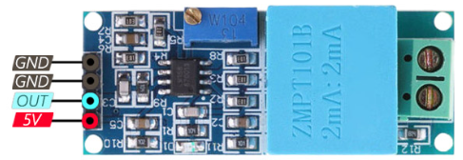
Our Aim for the project
AC Variac
Stepper Motor
Current Sensor
Voltage Sensor

Slide 3
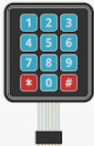
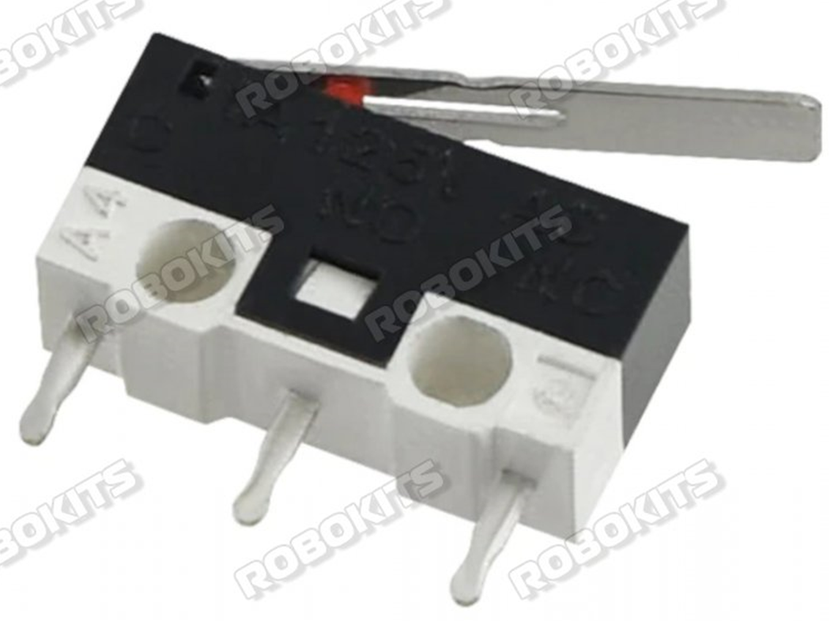
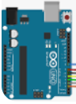
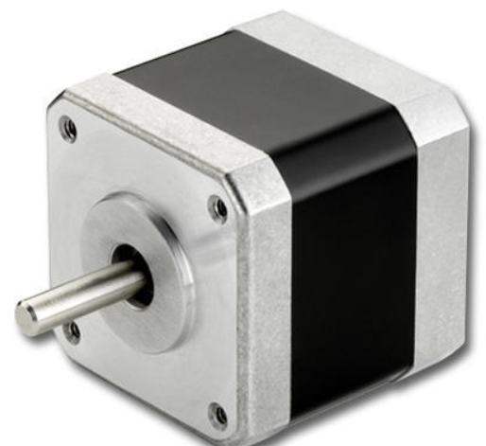
Device Architecture
STEP-1
STEP-2
STEP-3
STEP-4
STEP-5
RESETTING
GIVING USER INPUT
MICROCONTROLLER
DRIVER AND CONTROL CIRCUIT
VARIAC CONTROL
When the device starts we bring the variac to its initial position with the help of Limit switches
Using Keypad we give required power input to the device
Taking readings from voltage and current sensor we decide how to control device
Based on continuously feeding data from sensors we repeat steps 3 and 4 to control variac
After taking decision we direct our stepper motor via dedicated drivers

Slide 4
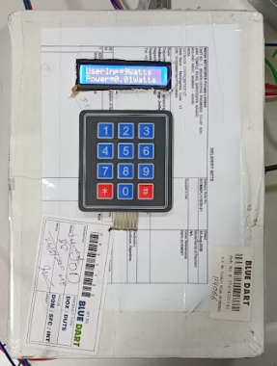
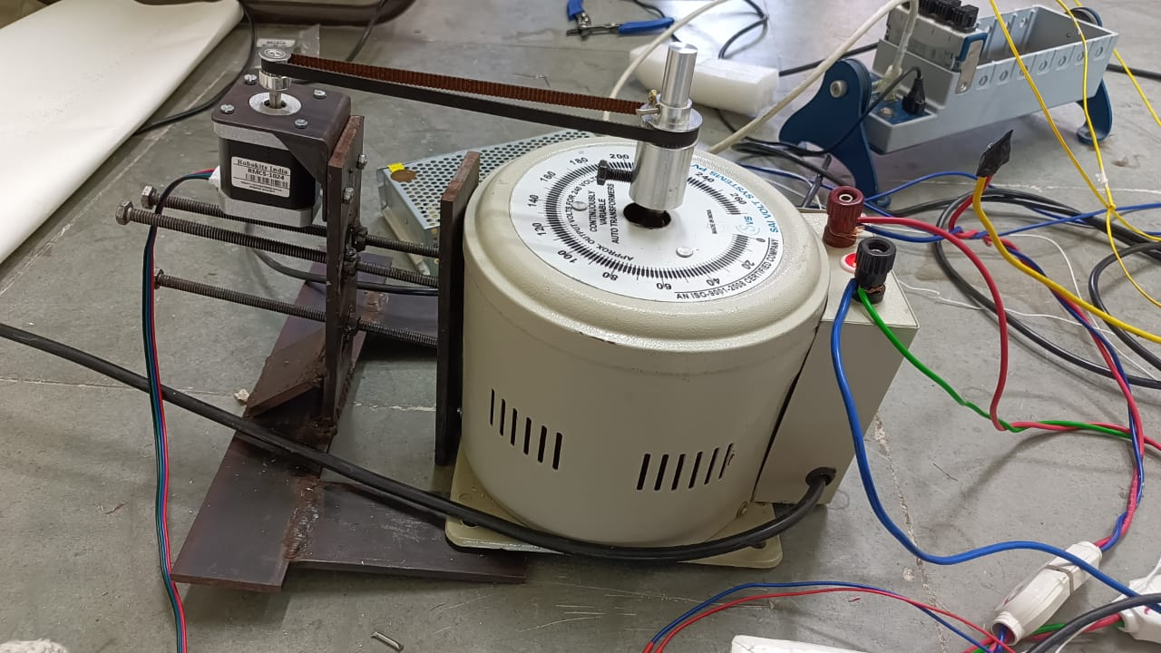
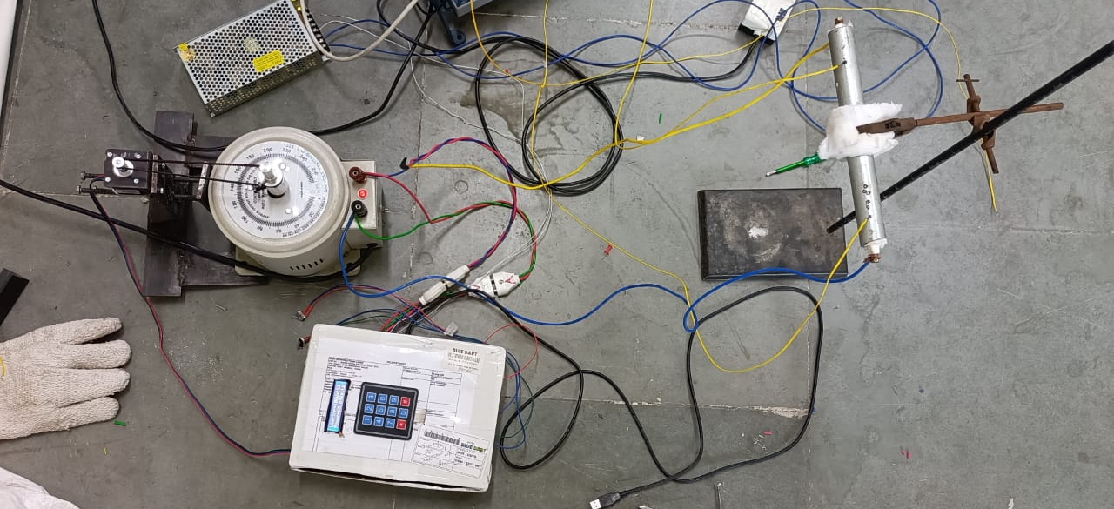
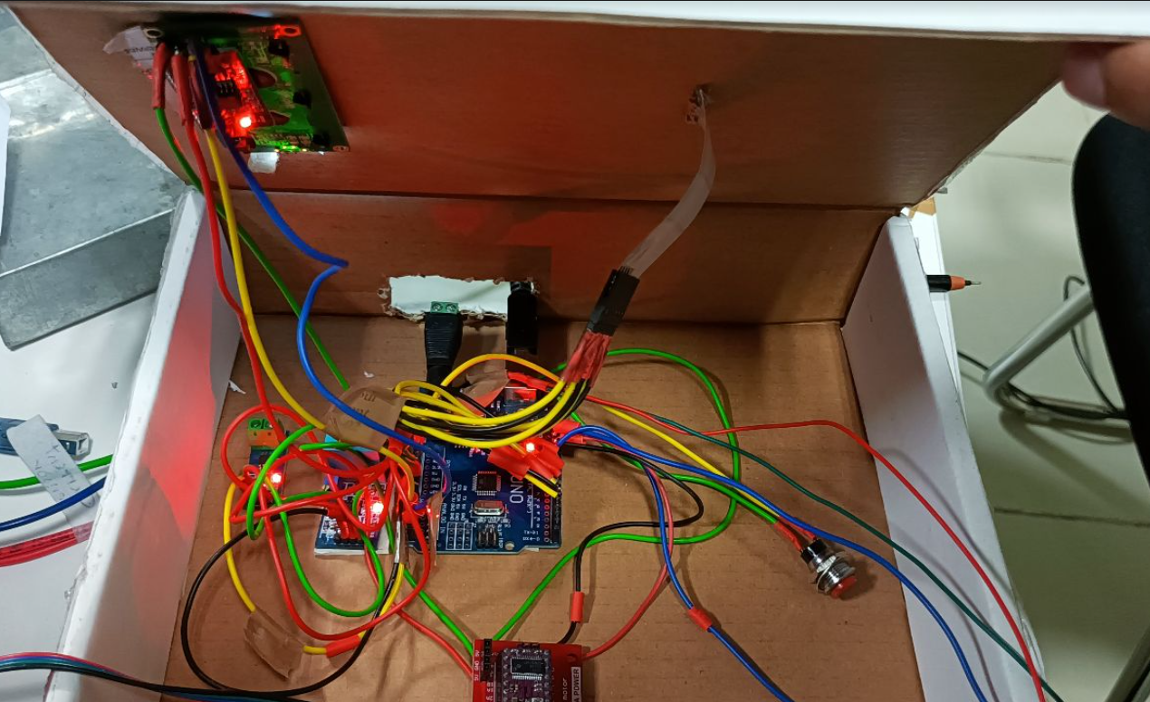
Our Device

Slide 5
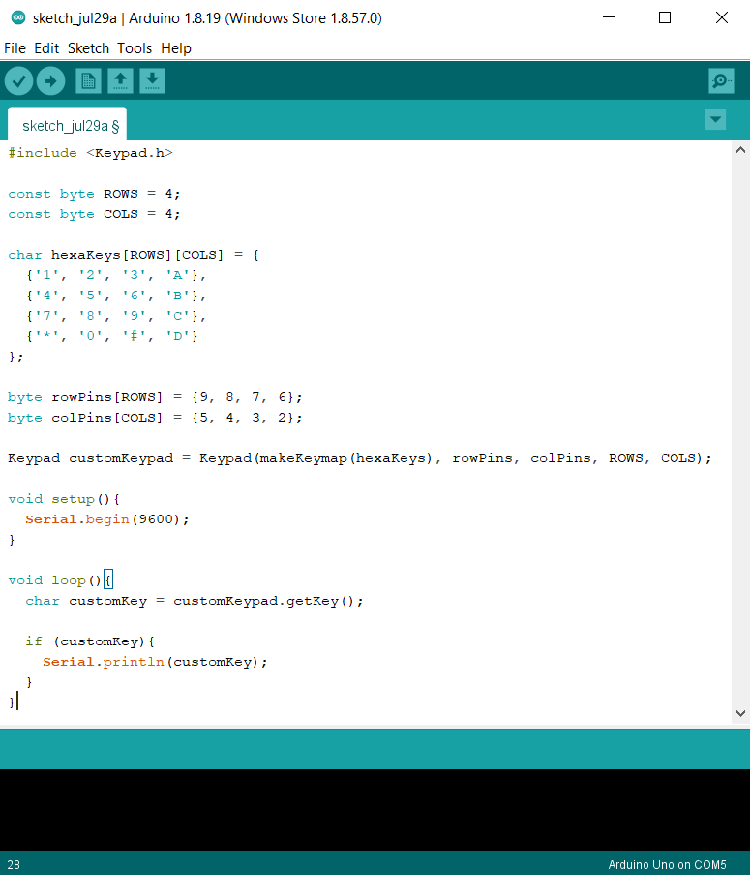
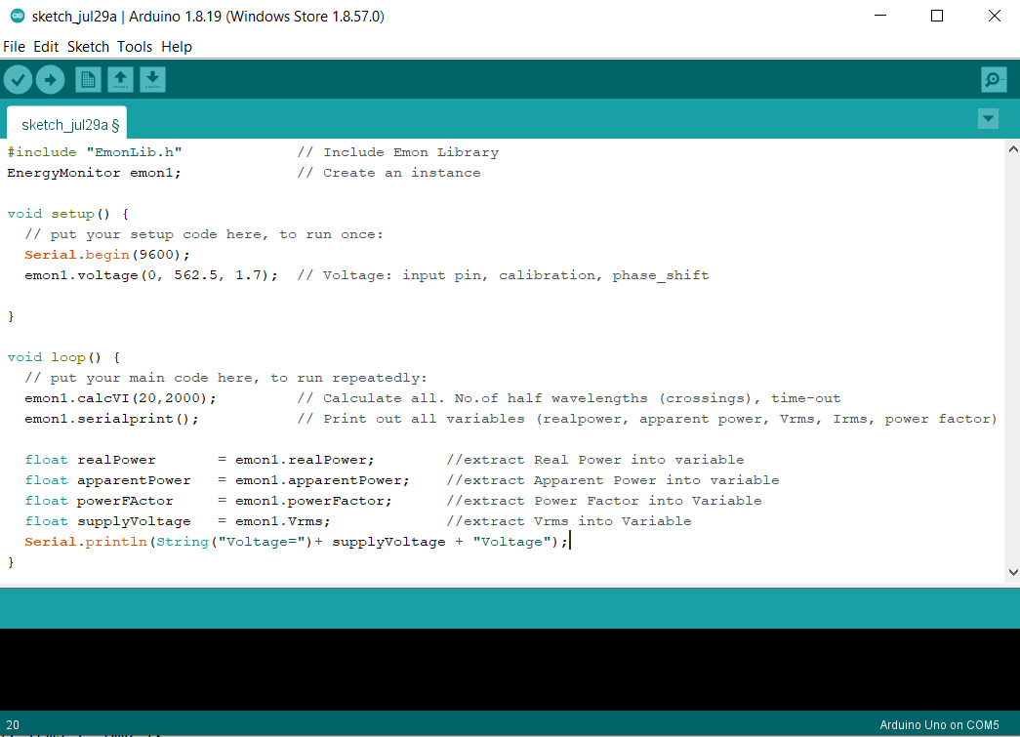
Code Part
My major contribution was in the controlling of Voltage sensor ZMPT101b and taking input via keypad

Slide 6
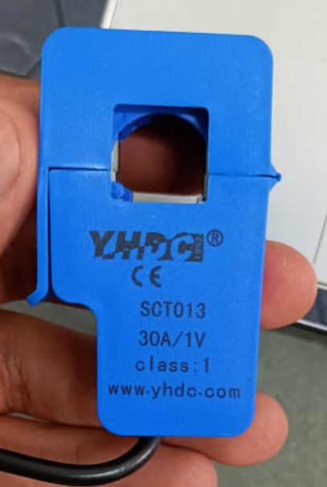
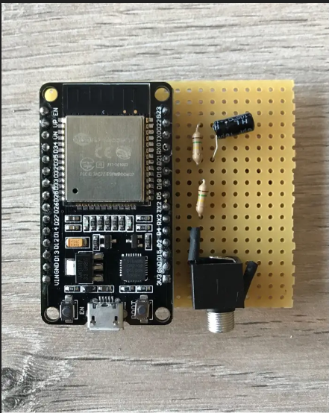
Future Scope
The current sensor ACS712 is a current sensor but it sometimes shows incorrect data so in order to increase the accuracy we can use a different sensor named SCT013. It is more expensive but due to a bigger coil provides more accuracy
Plus this device can be upgraded into an IOT based device where a researcher can setup the device and can monitor the status via his/her smartphone over a bluetooth or wifi connection using an ESP32 chip

Slide 7
List of Components Used
COMPONENTS | USES
Arduino Mega | To connect all the hardware components
ZMPT101B | To measure variac voltage
ACS712 | To measure variac current
Nema 17 Stepper Motor | To rotate variac shaft
Led Display | To display input and output
Keypad | To take user input
Me and Somil Maheshwari who are doing this project collectively are currently working on drafting a proper paper for the given device.
https://docs.google.com/document/d/19eu0ZI07kGT_iH85_kBw5iDBFLcigjXXyNTyQ8cGZp0/edit?hl=en&forcehl=1

Slide 8
Thank You

